Slide 1
Discussion 8: More Asymptotics

Slide 2
Administrivia
Project 2 Phase 2 due March 5th
Labs this week will be Project 2 checkoff
Sign up here!
HWs 2 and 3 upcoming due 3/14 and 3/19
Midterm 2 far in the future 3/20
Attendance: tinyurl.com/disc8-cz

Slide 3
Notation: Big O, Big Omega, Big Theta
Goal: Look at program complexity for large input
Notations:
Big O - bounds above
Big Omega - bounds below
Big Theta - bounds above and below
Notes:
Introduce the 3 common ways of assessing runtime. We’ll go in more detail on the next couple slides.
It’s important here that students know to represent runtime as algebraic inputs like 6n^2 + 9 for example.

Slide 4


O (Big O)
Let f(n) and g(n) be positive real numbers on inputs of size n
f ∈ O(g) if there is a constant c > 0 s.t. f(n) <= c g(n)
Upper bounded by g(n) when n gets significantly large.
Bound does not have to be tight.
True or false?
N² ∈ O(N²)
N² ∈ O(N⁵⁰⁰)
N log N ∈ O(N)
log N ∈ O(N²)
Notes:
Make sure students understand that big O is a worst case analysis of the program and is an upper bound on the runtime. Bound doesn’t have to be tight, meaning O(2^n) for an n^2 problem but generally, expect the tightest big O bound.

Slide 5
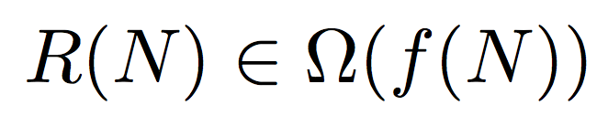
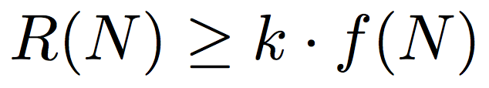
Ω (Big Omega)
Let f(n) and g(n) be positive real numbers on inputs of size n
f ∈ Ω(g) if there is a constant c > 0 s.t. f(n) >= c g(n)
Lower bounded by g(n) when n gets significantly large.
Bound does not have to be tight.
True or false?
N² ∈ Ω(N²)
N ∈ Ω(1)
N² ∈ Ω(N³)
Notes:
Same idea, but with big omega

Slide 6


Θ (Big Theta)
Let f(n) and g(n) be positive real numbers on inputs of size n
f ∈ Θ(g) if there is a constant c1 > 0 and c2 > 0 s.t.
C1 g(n) <= f(n) <= c2 g(n) for all c1 <= c2
Tightly bounded by g(n) when n gets significantly large.
• f ∈ Ω(g) and f ∈ O(g)
Notes:
The important point here is big theta is just squeezing the runtime between big O and big Omega. It’s a tight bound so best and worst case. Always case.

Slide 7
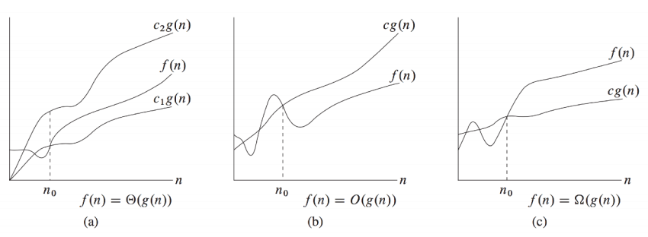
Introduction to Algorithms, Cormen, Leiserson, Rivest, Stein
Notes:
Good visual example. Important to note that for small inputs, bounds could be wrong but as n -> infinity, we see how the bounds.

Slide 8
Conventions: No Constants
Drop multiplicative constants and lower order terms
Any exponential dominates any polynomial
Any polynomial dominates any logarithm

Slide 9
Common Asymptotic Sets
O(1): constant
O(log n): logarithmic
O(sqrt(n)): square root
O(n): linear
O(n log n): linearithmic
O(n^2): quadratic
O(n^3): cubic
O(2^n): exponential
O(n!): factorial
Notes:
Good recap after the first problem.

Slide 10
Techniques for Analyzing Runtime
Annotate your code
Write down runtimes of called functions
Consider end conditions for loops and consequently the number of times we could run the loop
What are the terminating conditions for a loop?
Can we algebraically express the runtime of the loop?
Branching factor
Do we make additional calls and if so, how many subproblems do we make?

Slide 11
Analyzing Runtime Example
public void hello(int n) {
if (n == 0) {
return;
} else {
for (int i = 0; i < 5; i += 1) {
System.out.println(“hello”);
}
hello(n-1);
}
}
Let’s draw the “work done” tree!

Slide 12
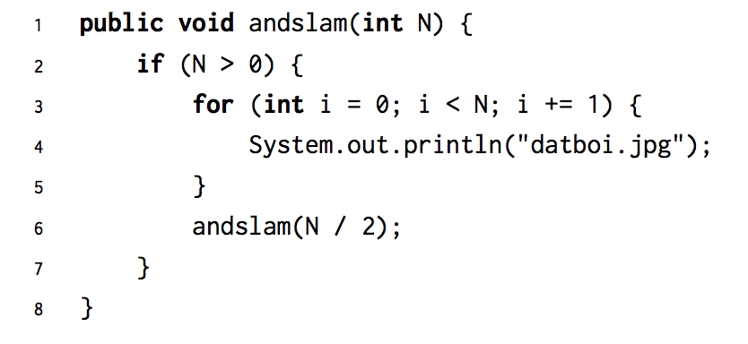
Problem 1.1

Slide 13
Problem 1.1
Θ(N)
Log n levels of work and each level is O(n)

Slide 14
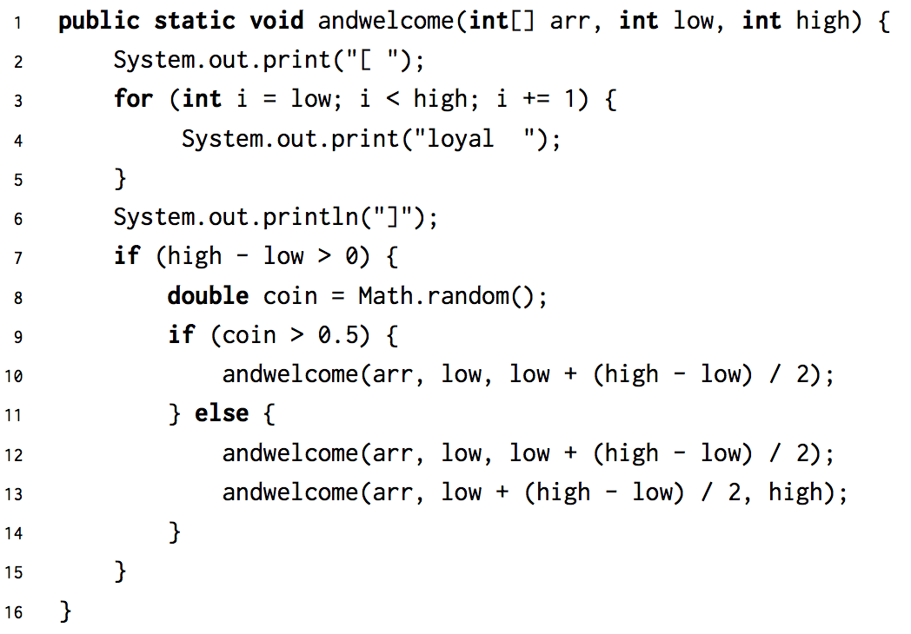
Problem 1.2

Slide 15
Problem 1.2
Θ(N log N)
Log n levels of work, but have a branching factor of 2 and each level is O(n) in the worst case

Slide 16
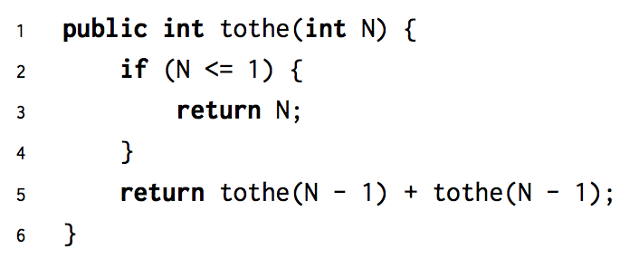
Problem 1.3

Slide 17
Problem 1.3
Θ(2^N)
2^i nodes per layer and each node does O(1) work

Slide 18
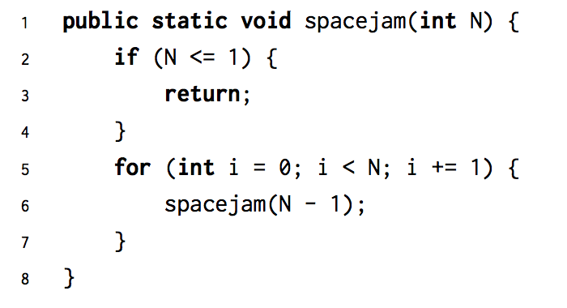
Problem 1.4

Slide 19
Problem 1.4
O(N * N!)
n-i work per node and n! / (n-i)! nodes per layer.

Slide 20
Problem 2.1
Don’t forget your definition for Ω , Θ, and O!

Slide 21
Problem 2.1
Algorithm 1
Neither
Neither
Algorithm 2
Neither

Slide 22
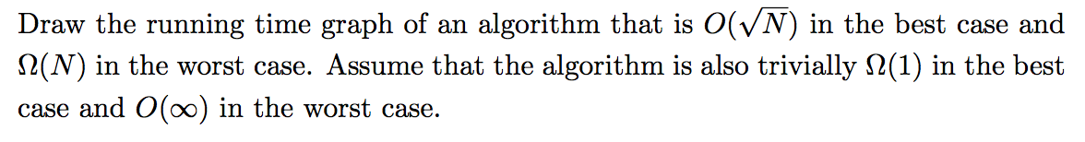
Problem 3.1

Slide 23
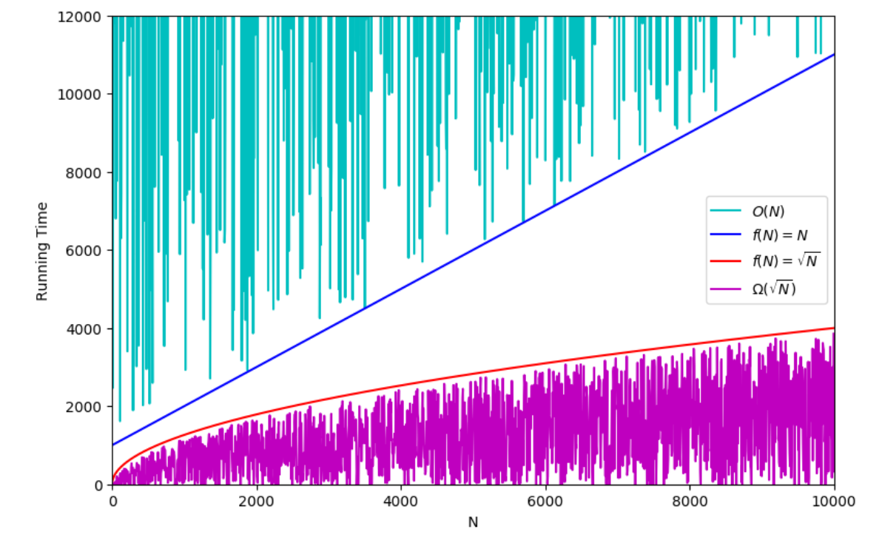
Problem 3.1

Slide 24
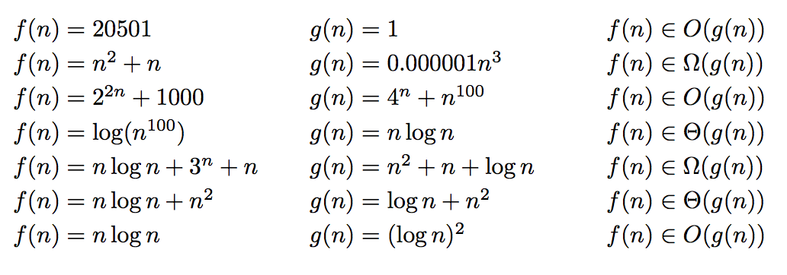
Problem 3.2: True or False?
Notes:
Teaching Goals: Understand that you can drop constants and ignore lower orders of growth, comparing different runtimes

Slide 25
Problem 3.2: True or False?
True
False
True
False
True
True
False

